Slide 1

ONLINE LEARNING PLATFORM USING MERN STACK
TEAM MEMBERS:
Keerthana.R
Kadhambari.K
Yogesh.S
Sasikumar
Meiyaperumal

Slide 2

OBJECTIVE:
Develop a comprehensive online learning platform with three user types (Student, Teacher, Admin), featuring course creation, approval process, and live video conferencing.

Slide 3

OVERVIEW
Introduction
Dashboard
Payment Integration
Features
Couse Purchase
Conclusion
User Authentication
Live Video Conferencing
Thank You
Application Approval
Communication

Slide 4

INTRODUCTION
This project aims to develop a comprehensive online learning platform using the MERN stack, catering to Students, Teachers, and Administrators. It will facilitate course creation and management, incorporating a rigorous approval process to ensure quality content. The platform will also feature live video conferencing for real-time interaction between students and instructors. By enhancing accessibility and engagement, this platform seeks to revolutionize the online learning experience. Join us in building an innovative educational environment that bridges geographical divides.

Slide 5
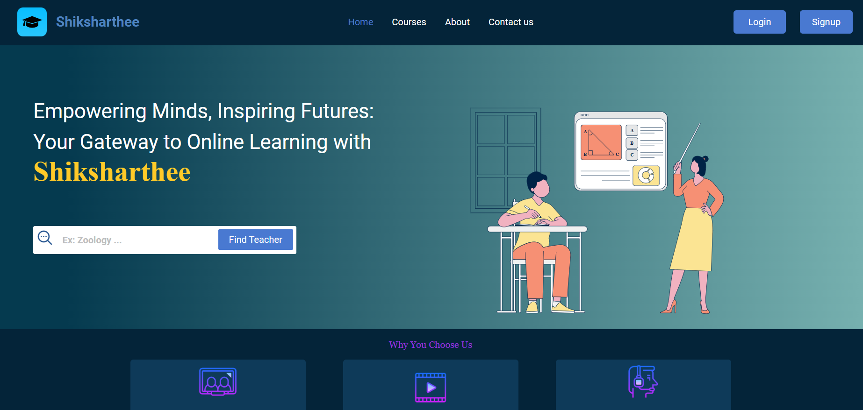
FEATURES

Slide 6
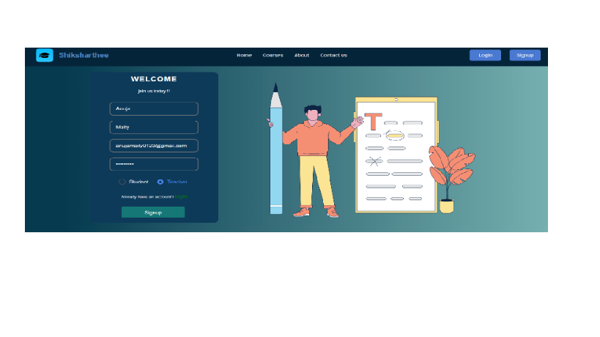
USER AUTHENTICATION
1.Student Login
2.Teacher Login
3.Admin Login

Slide 7
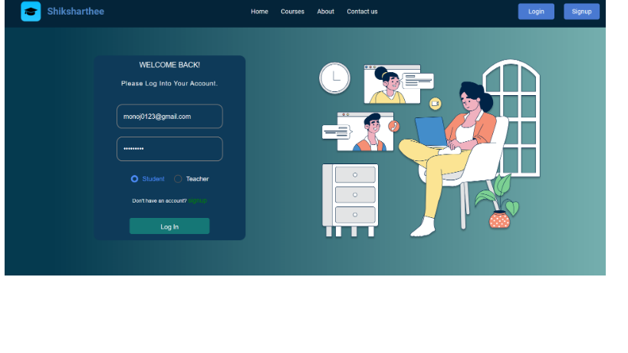

Slide 8
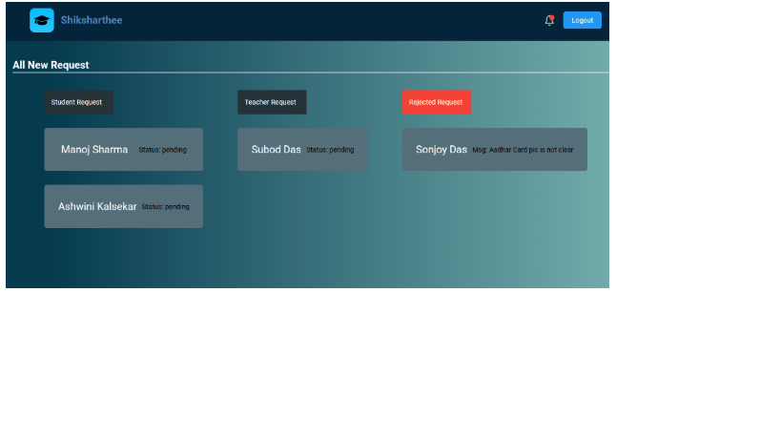
APPLICATION APPROVAL
1.Students and teachers can submit applications for approval.
2.Admin validates and approves applications.

Slide 9
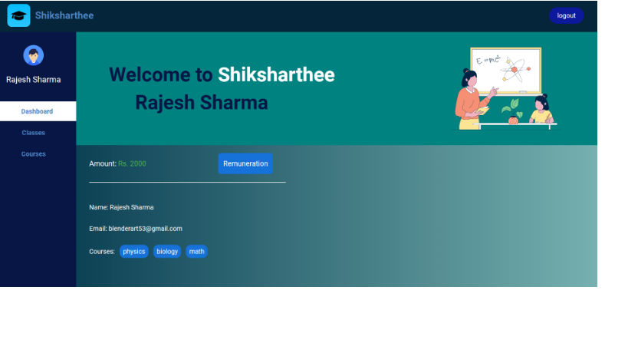
DASHBOARD
Students see purchased courses, progress, and communication options.
Teachers view created courses, student enrollments, and communication features.

Slide 10
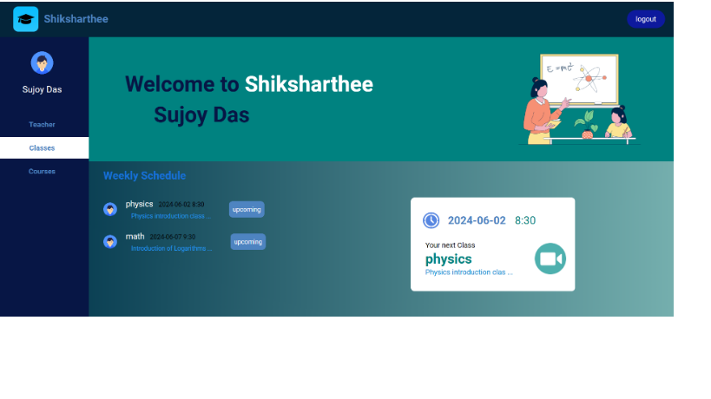

Slide 11
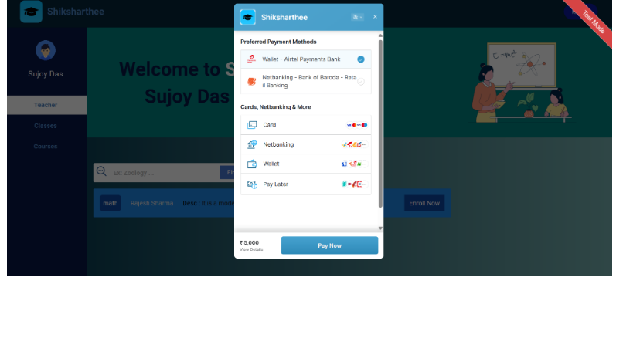
COURSE PURCHASE
Students can browse and buy courses on the platform.

Slide 12
LIVE VIDEO CONFERENCING
Integrated video conferencing tool (similar to Google Meet) for real-time teacher-student interaction.

Slide 13
COMMUNICATION
In-platform messaging system for communication between teachers and students.

Slide 14
PAYMENT INTEGRATION
Integrate a secure payment gateway for course purchases.

Slide 15
TECH STACK
Database:
MongoDB for storing user profiles, course details, and application data.
Authentication:
JWT (JSON Web Tokens) for secure authentication.
Video Conferencing:
Integrate WebRTC for real-time video communication.
Or just using google meet link
Payment Integration:
Stripe or PayPal or razorpay for secure and seamless payments
UI/UX:
Figma
Dribbble
Frontend:
React (Vite) for dynamic and responsive UI.
Backend:
Node.js, Express and Mongoose for server-side development.

Slide 16

CONCLUSION
The online learning platform built using the MERN stack effectively serves students, teachers, and admins with tailored features like user authentication, application approval, and dashboards. It facilitates seamless course purchases and real-time interactions via integrated video conferencing. In-platform messaging enhances communication, while secure payment gateways ensure smooth transactions. With a modern tech stack, the platform offers scalability, responsiveness, and a user-friendly experience. This project sets the foundation for an engaging and efficient online learning environment.

Slide 17

THANK YOU

